Slide 1

Presentation on Virtual Trial Room
Kantipur City College
Putalisadak, Kathmandu
Purbanchal University
Presented by: Manisha Gaire (381569)
Roshan Kumar Mahato (381574)
Sandesh Dhungana (382722)

Slide 2
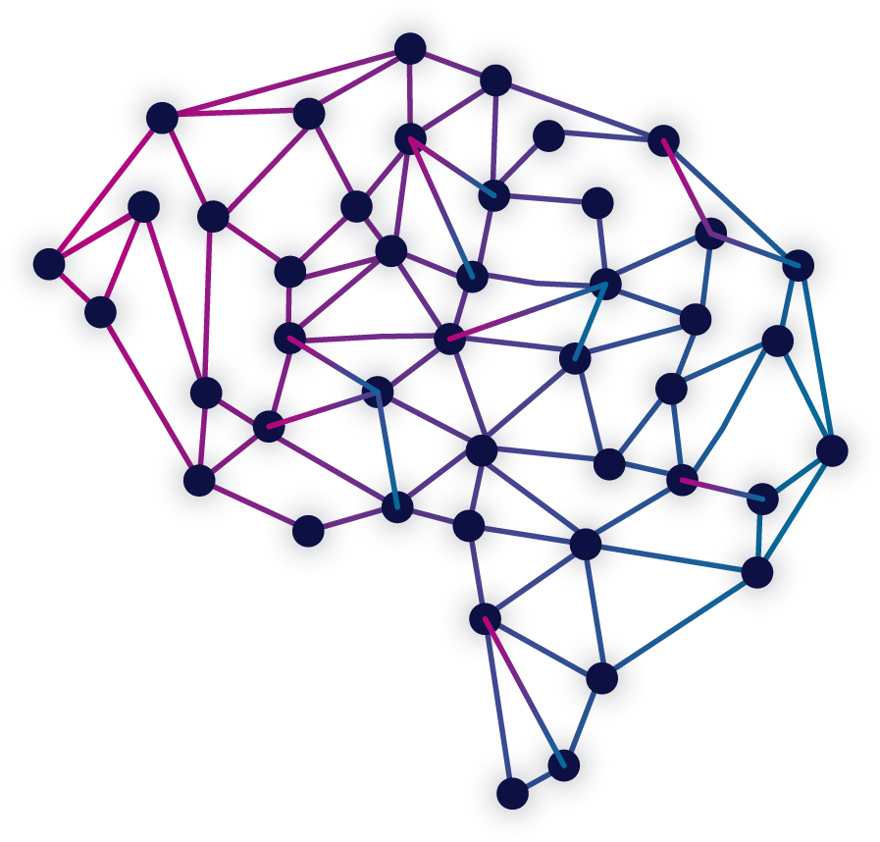
Table of contents
Introduction
Problem Statement
Objectives
Features
Tools
System Development Life Cycle
System Block Diagram
Data Flow Diagram
Model for Virtual Trial Room
Convolution Layer
Max Pooling
Padding

Slide 3
Activation Function
Loss Function
U-Net Architecture
Train-Test Split
Snap-Shot
Gantt Chart
Business Model
Limitations
Future Enhancement

Slide 4
Abbreviation
VTR = Virtual Trial Room
U- Net = U shaped Network model
E = Encoder
D = Decoder
Z = Noise of Background

Slide 5
Introduction
Fashion and Technology Fusion: The Virtual Trial Room project combines fashion and technology to revolutionize the shopping experience, allowing users to virtually try on clothes.
Personalized Clothing Exploration: Users can upload their pictures and select clothing items, and the VTR uses machine learning models to show how these clothes will look on them.
Convenience and Time Savings: The VTR eliminates the need for physical try-ons, saving users valuable time while enabling them to explore different outfits and find their ideal style.
Valuable Insights for Stores: Beyond benefiting shoppers, the VTR provides stores with valuable data on customer preferences, helping them tailor their offerings to meet customer demands more effectively.

Slide 6
Problem Statement
The VTR provides buyers with a unique and interactive solution to virtually try on clothes before making a purchase.
Solving the losses for the seller due to refunds and dissatisfied customers.

Slide 7
Objectives
To achieve realism, the VTR utilizes advanced machine learning models for clothing segmentation, pose estimation, and cloth try-on visualization.
To offer a virtual try-on experience where users can upload images and select cloth image.

Slide 8
Features
Virtual Try-On: Users can virtually try on clothes by uploading their images and visualizing how the chosen clothes look on themselves without physically wearing them.

Slide 9
Tools
Python v3.10.12
Matplotlib v3.7.1
Torch v2.0.1
OpenCV-python v4.7.0.72
Detectron2 v0.6
CUDA Compilation tools v11.8.89, NVIDIA 2005-2022, on colab.
Torchvision v0.15.2
Mediapipe v0.10.3

Slide 10
System Development Life Cycle
Prototype Model:
Resource Efficiency: Building a full-scale model from the outset can be resource-intensive, while a prototype can be created with fewer resources.
Testing and Improvement: It lets us test our project and make it better, even if we don't have real users.
Learning Opportunity: Building a prototype helps us learn and practice the important concepts and skills needed for our project.

Slide 11
Why Prototype Model?
Quick way to show the project's core idea and how it works.
Allows for testing and feedback, even without real users.
Efficient use of resources in a college project.

Slide 12
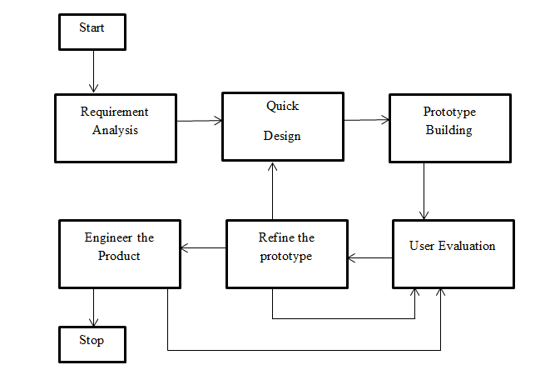
System Development Life Cycle

Slide 13
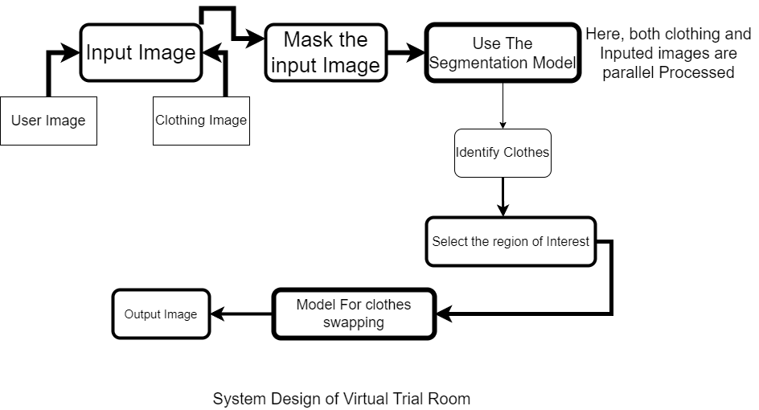
System Block Diagram

Slide 14
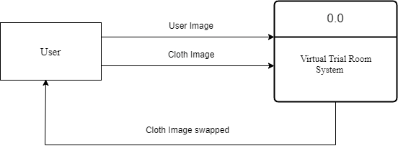
Data Flow Diagram

Slide 15
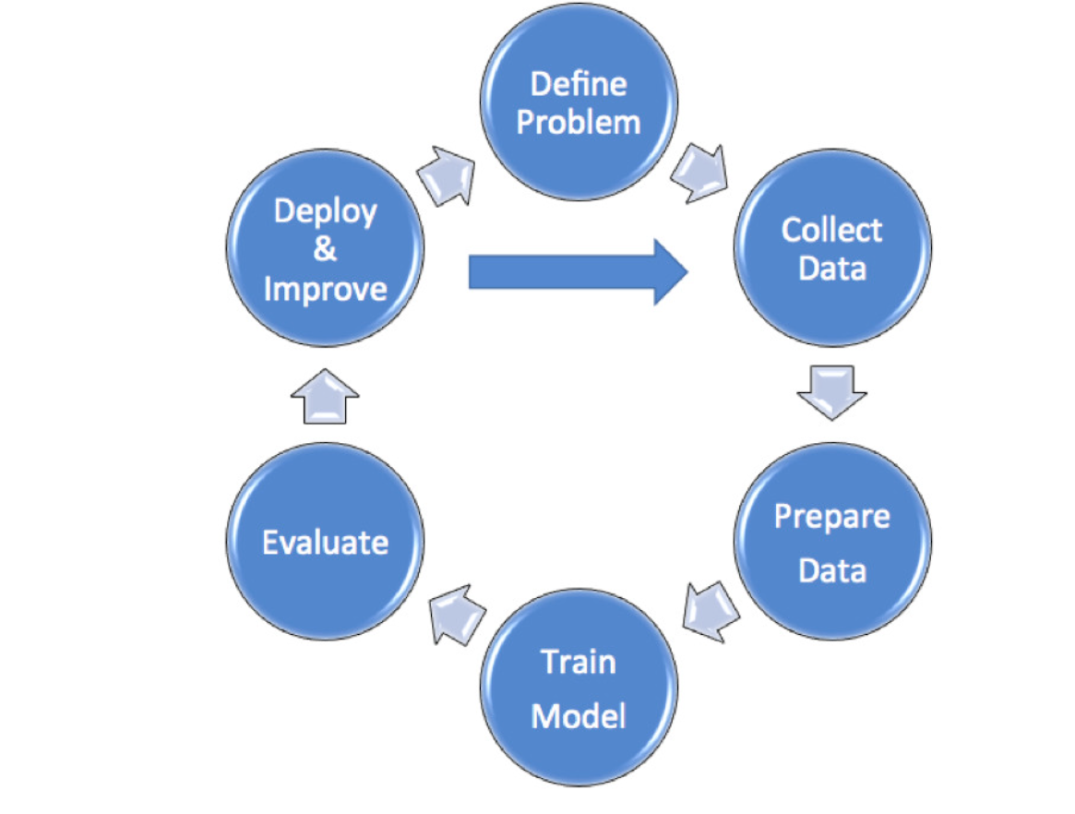
Model Building Life Cycle

Slide 16
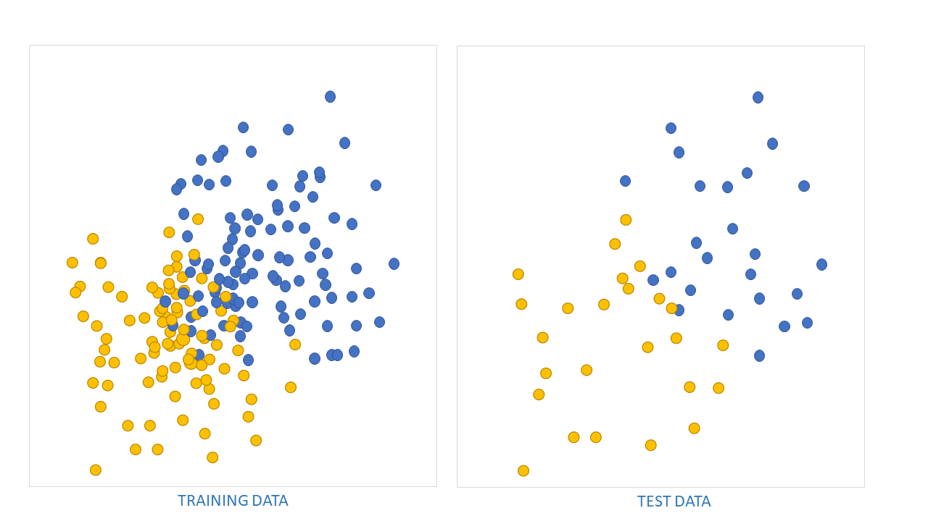
Train Test Split (70-30)

Slide 17
Model For Segmentation
What is U-Net?
A neural network architecture for image segmentation tasks
How U-Net Works?
Encoder: Reduces image size in terms of pixel, captures key features.
Decoder: Up sampling to original size, maintains details.
Skip Connections: Links encoder and decoder for details extraction.

Slide 18
U-Net
Applying U-Net architecture for Clothing Segmentation and overall cloth swapping.
We collected and prepared clothing image dataset for training and testing.
Define U-Net model with encoder-decoder structure.
Train the model to learn clothing boundaries.

Slide 19
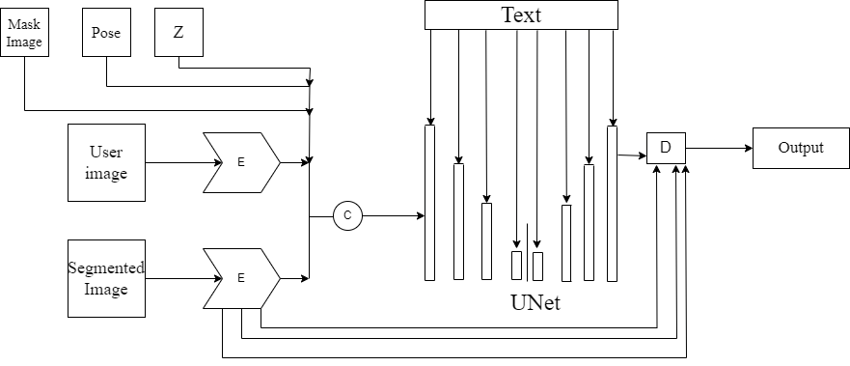
Unet Architecture

Slide 20
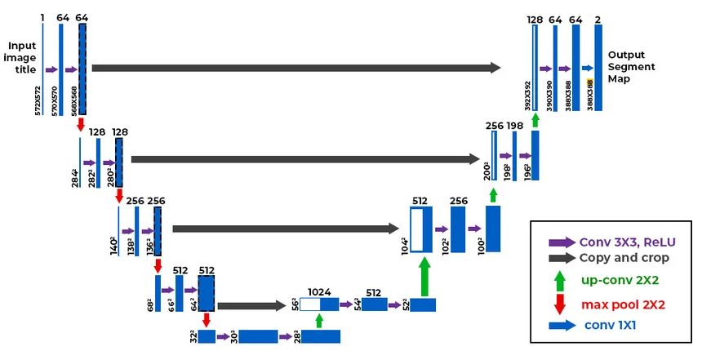

Slide 21
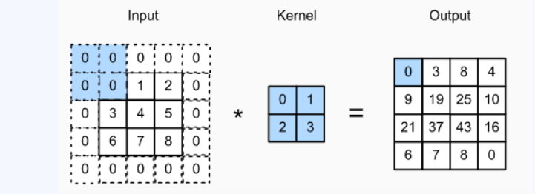
Convolution Layer
What it Does: Imagine it's like a magnifying glass that looks at small parts of an image at a time. It helps the computer see patterns, like edges or shapes, in pictures.
Why it's Important: Convolution layers are essential for the Virtual Trial Room because they help the computer understand the details of clothing and how it fits on the user's body.

Slide 22
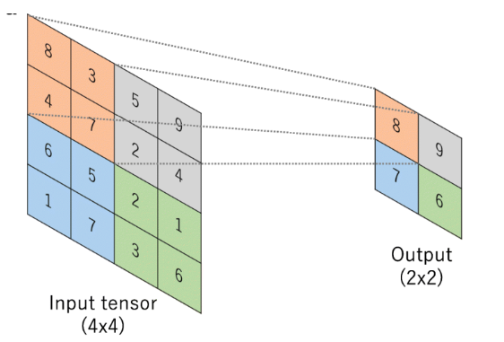
Max Pooling
What it Does: Think of it as a filter that keeps only the most important information. It takes the highlighted parts from the convolution layer.
Why it's Important: Max pooling simplifies the information the computer needs to process. It helps speed up the Virtual Trial Room and make it work faster.

Slide 23
Padding
What it Does: It's like extending the edges of the image to make sure no important details get cut off.
Why it's Important: In the Virtual Trial Room, it ensures that no clothing details are lost during processing, giving users a more accurate view of how the clothes will look on them.

Slide 24
Activation Function
ReLU (Rectified Linear Unit) is like an ON-OFF switch for neurons in neural networks.
It's simple and fast, making it a popular choice in deep learning.
When the input is positive, lets it pass unchanged, acting like an accelerator pedal.
If the input is negative, it blocks it completely, acting like a brake pedal.
ReLU helps neural networks learn quickly and is crucial in image recognition and Virtual Trial Room development.
Think of it as a way for the computer to decide when to be excited (positive) and when to stay quiet (negative)

Slide 25
Loss Function
Cross-Entropy is a special kind of calculator that helps a computer learn from its mistakes.
It measures how well the computer's guesses match the right answers when solving problems.
If the computer's guess is close to the right answer, Cross-Entropy gives a small number (like 0).
If the computer's guess is far off, Cross-Entropy gives a big number, telling the computer it needs to adjust its guesses. It's like a teacher grading homework, but for the computer!

Slide 26
Business Model
Subscription Model: Charge users a monthly or yearly fee to access the Virtual Trial Room service.
B2B Model: Collaborate with clothing brands and shops, offering them the Virtual Trial Room technology to enhance their online shopping platforms and reduce returns.
B2C Model: Charge individual customers for access to the Virtual Trial Room feature, allowing them to virtually try on clothing and accessories while shopping online.

Slide 27
Limitations
Not Yet Implemented on E-commerce sites
Requires High-Quality Images
Limited Accessibility
Untested Efficacy in Real-World Setting

Slide 28
Future Enhancement
Integration in a e-commerce website.
Application Program Interface (API) form.

Slide 29
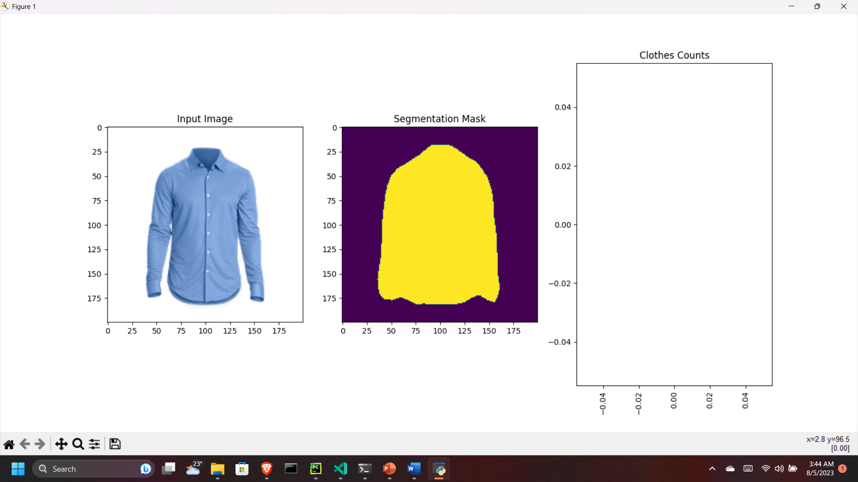

Slide 30
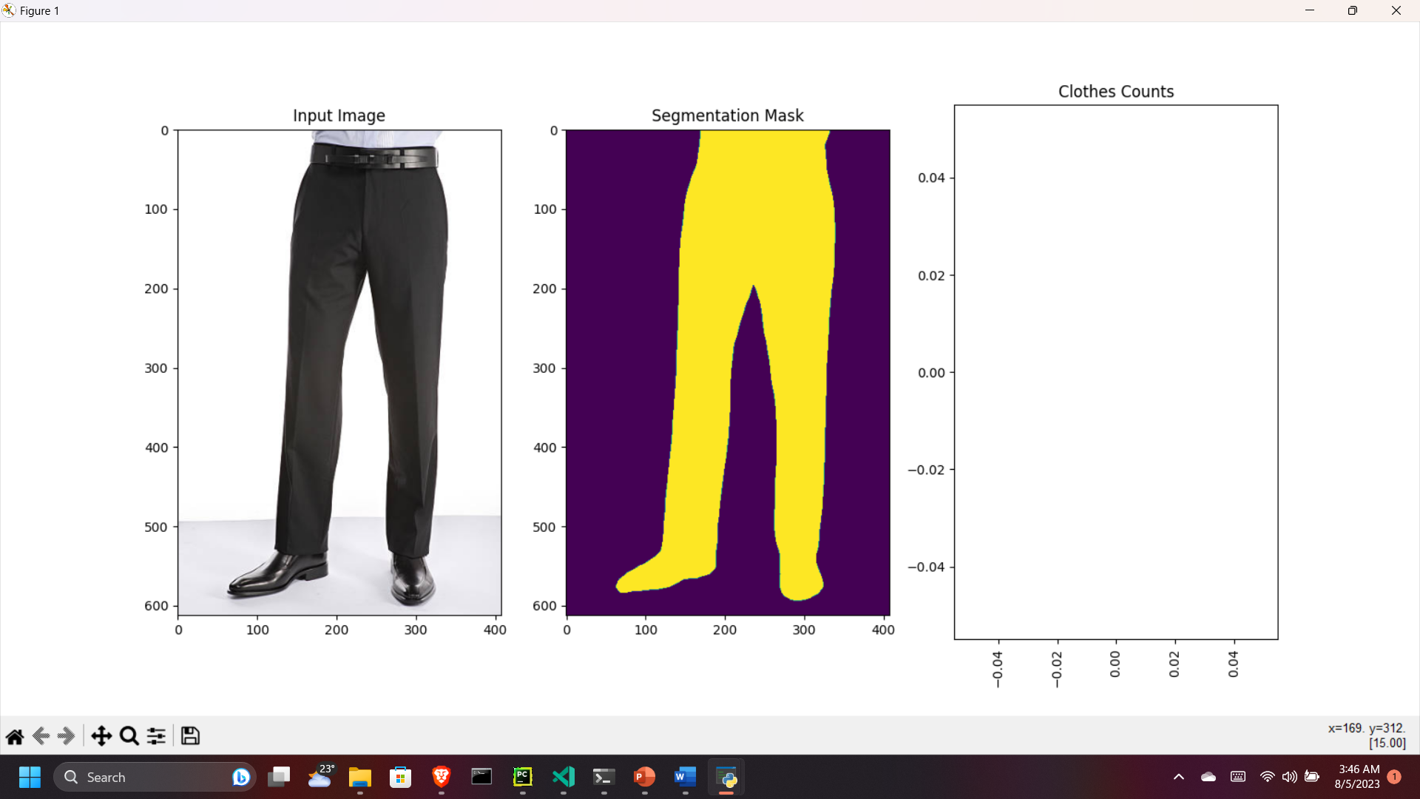

Slide 31
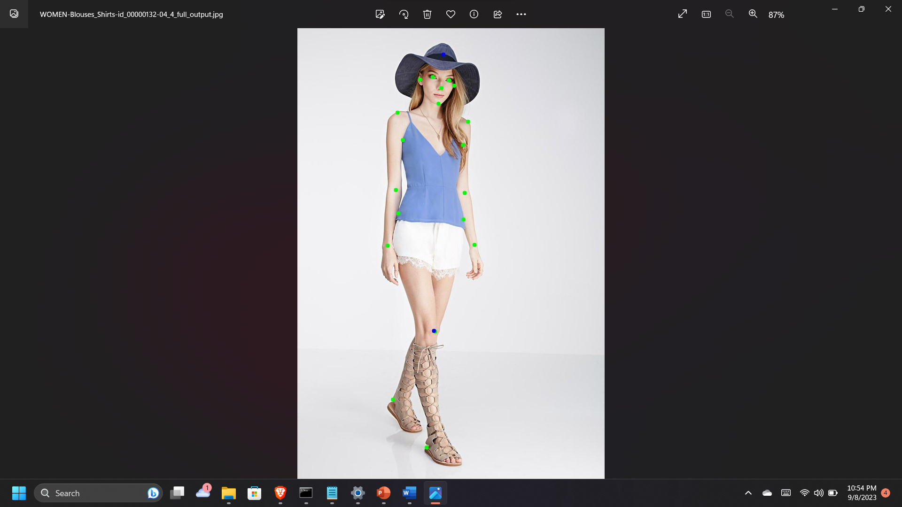

Slide 32
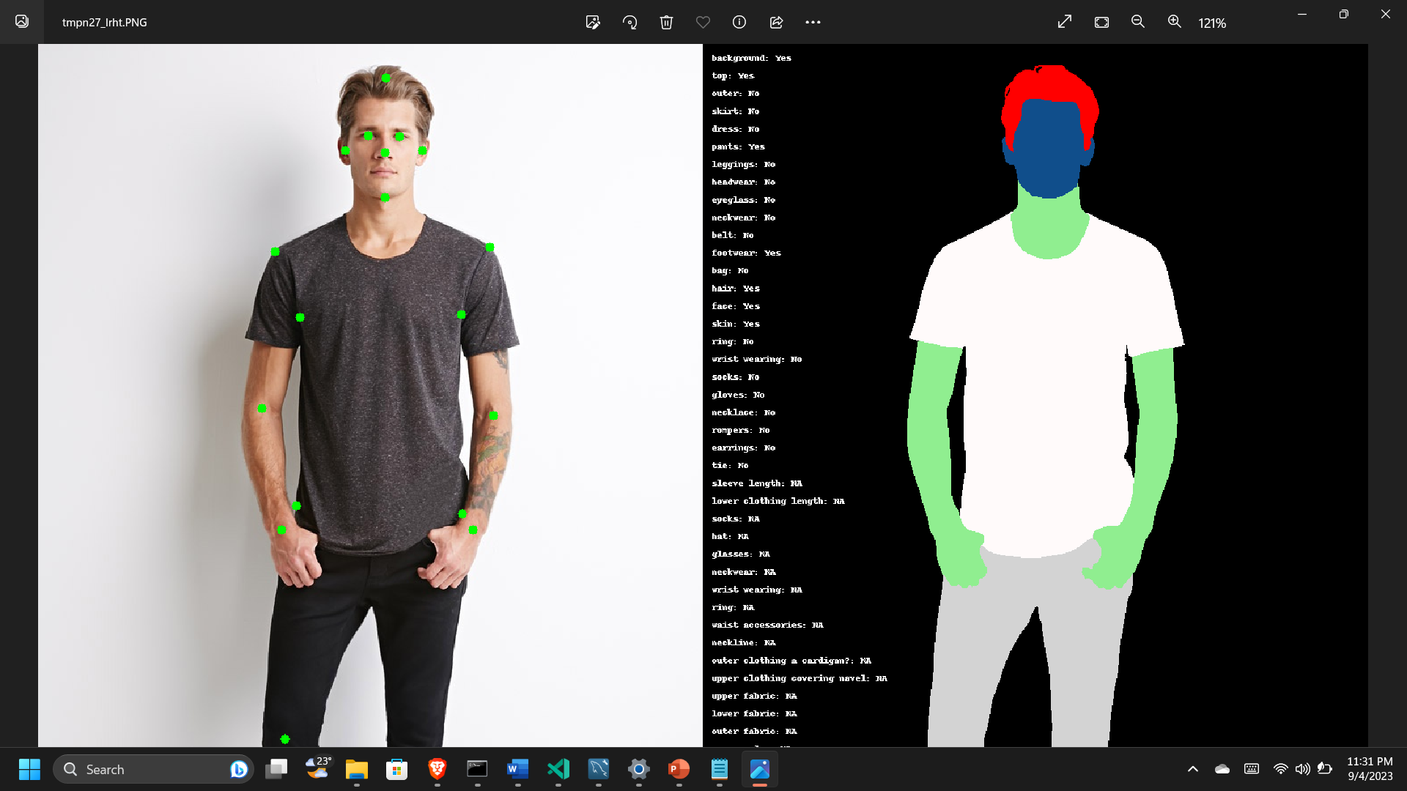

Slide 33
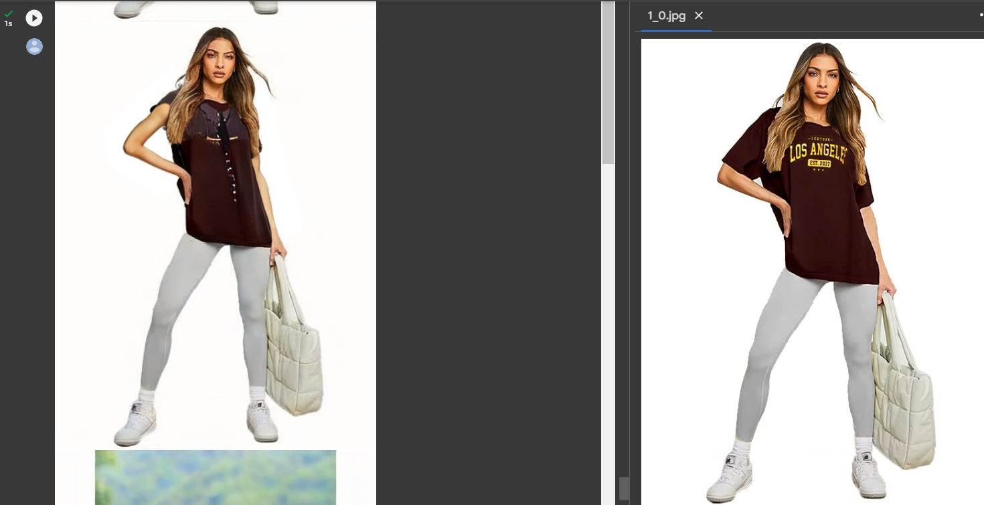

Slide 34
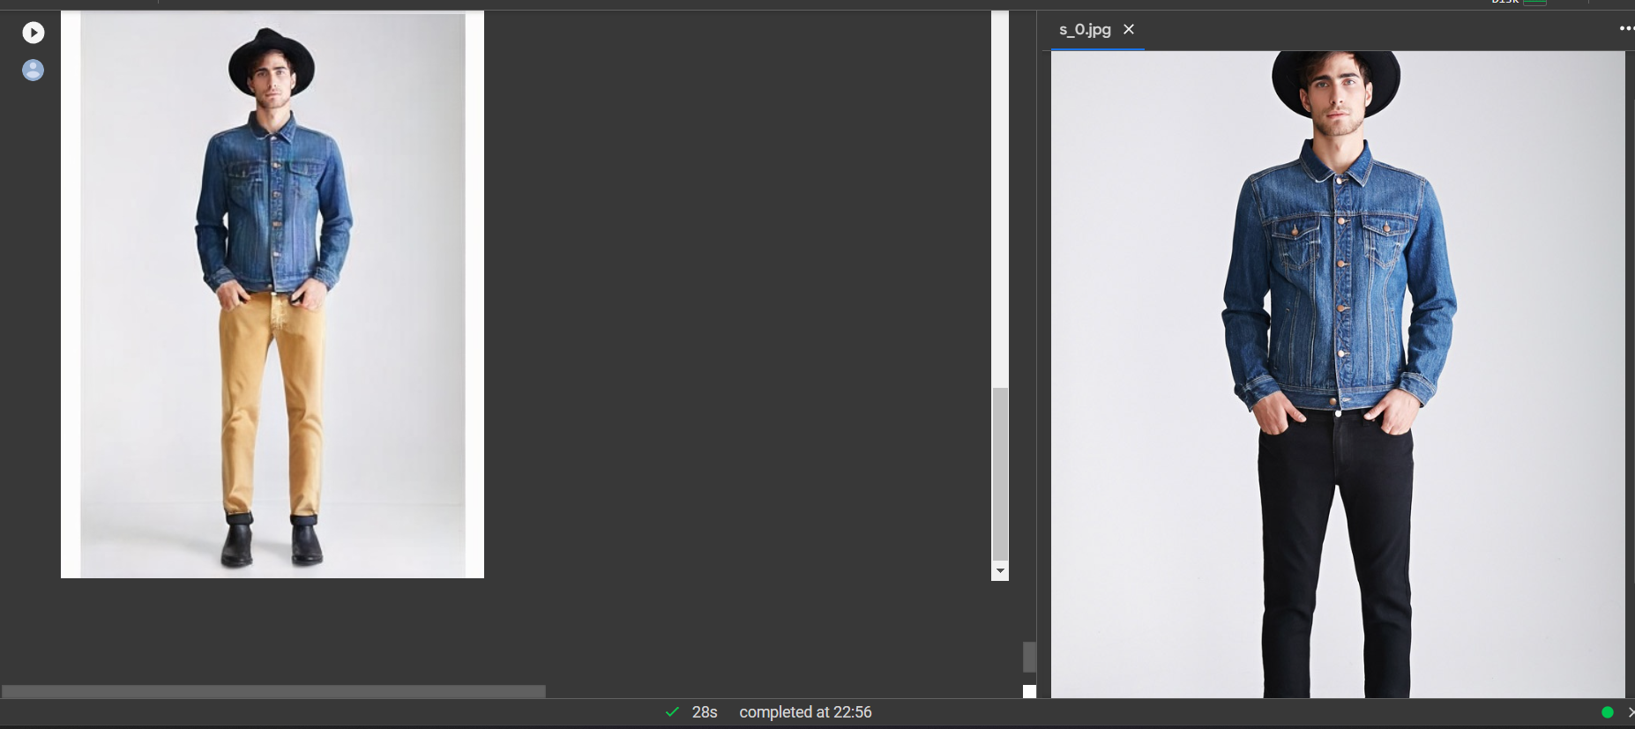

Slide 35
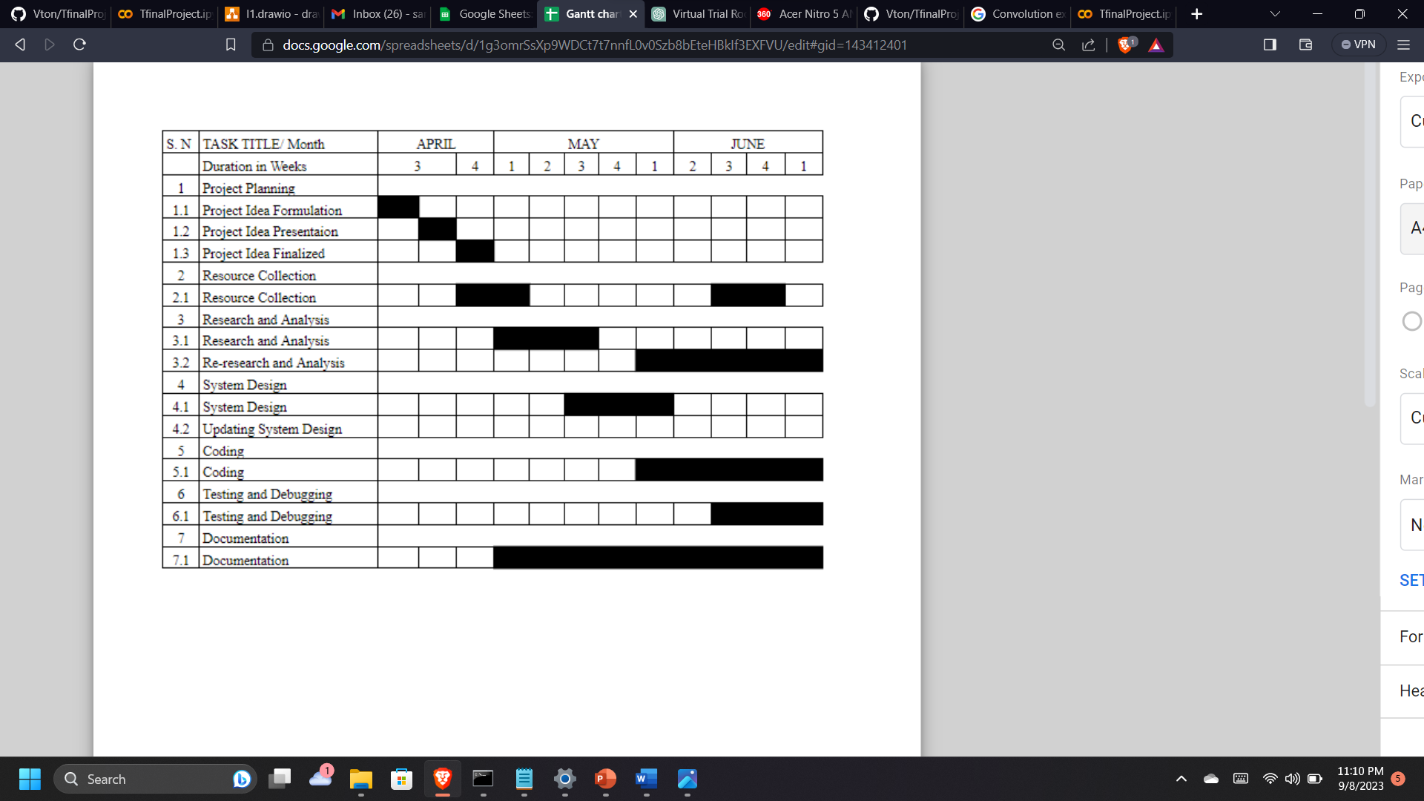
Gantt Chart
Table 4.2.3.1 Gantt Chart

Slide 36
Any Queries? Thank You

